Slide 1
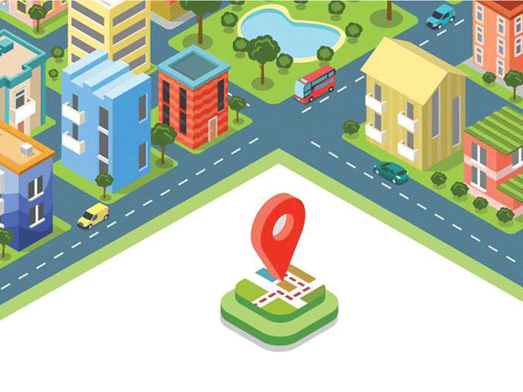
PROJECT
DIGITAL ADDRESSEE SYSTEM WITH UNIQUE ADDRESS OF EACH ADDRESSES LOCATION

Slide 2
DIGITAL ADDRESSEE SYSTEM WITH UNIQUE ADDRESS FOR EACH ADDRESSEE LOCATION
INTRODUCTION
HISTORY
OBJECTIVES OF PROJECT
USES OF PROJECT
EXISTING SYSTEM
ADVANTAGES
BIBLIOGRAPHY

Slide 3
INTRO….
The world bank in 2005 said that addressing is a real problem. Which is why you see countries
going through a new address system every 20 years.
The existing limited address database has
merely the physical addresses.
The data base lacks geo-spatial information and any
standardized format of addressing.
The aim is to making a remembering and accessing a location easy and efficient.

Slide 4
HISTORY
Until the 18th and 19th centuries, most houses and buildings were not numbered.
Naming and numbering began under the age of Enlightenment.
There as in the mid 18th century. Numbering allowed everyone to efficiently receive mail,
as the postal system.

Slide 5
OBJECTIVES OF PROJECT
While booking mail articles/money orders etc., complete address of
the addressee/payee is captured and stored in the database.
But this data is not used for any purpose once the
article/money order is
delivered/paid.
The address will be a 12 digit numeric code of which the first
6 digit is the pin code and last is the combination of numbers.
This is assigned per building/flat.

Slide 6
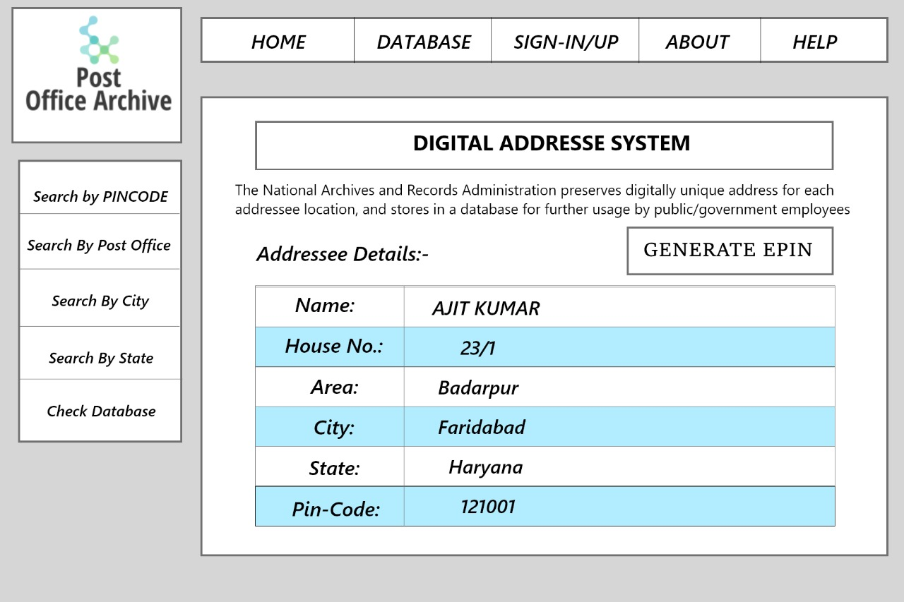

Slide 7
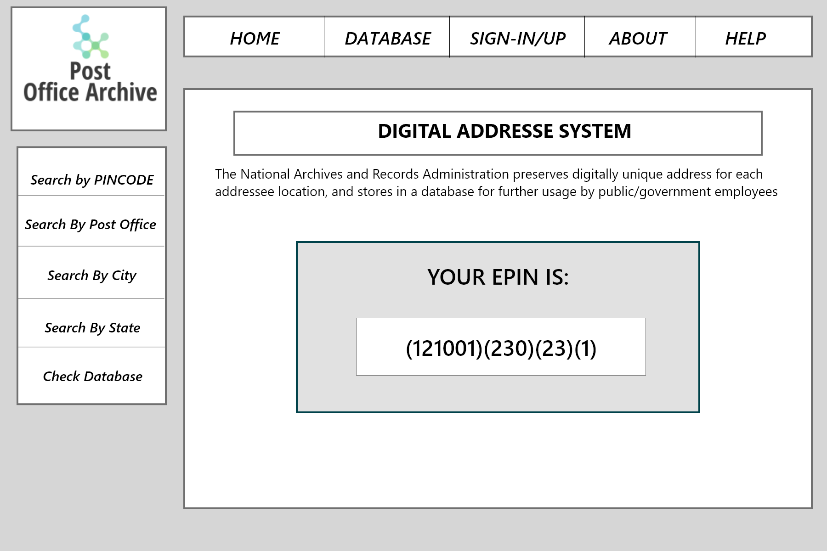

Slide 8
MODULES USED:
SELENIUM
PANDAS
Mongodb
Pyqt5
WEBDRIVER- gECODRIVER, cHROMEdRIVER
TIME
VS-Code

Slide 9
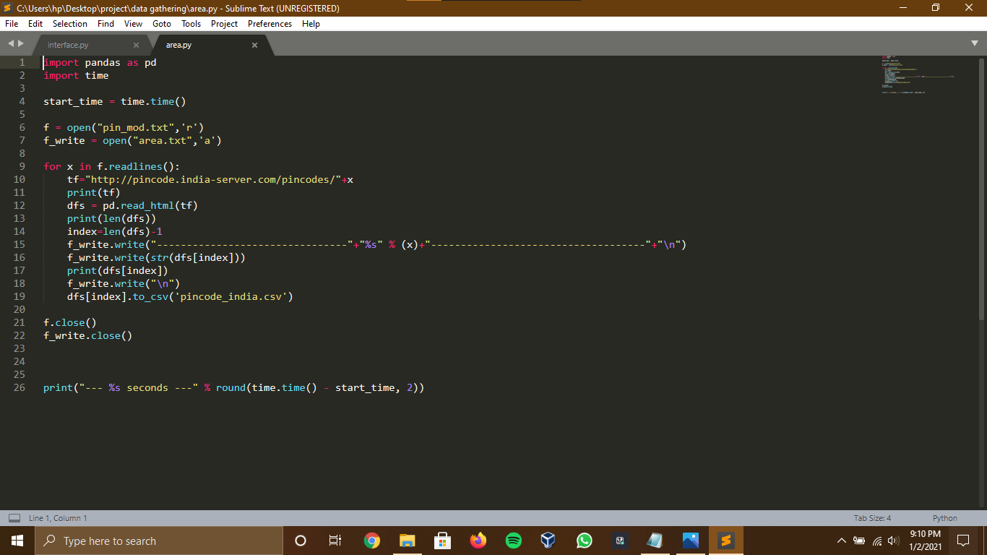

Slide 10
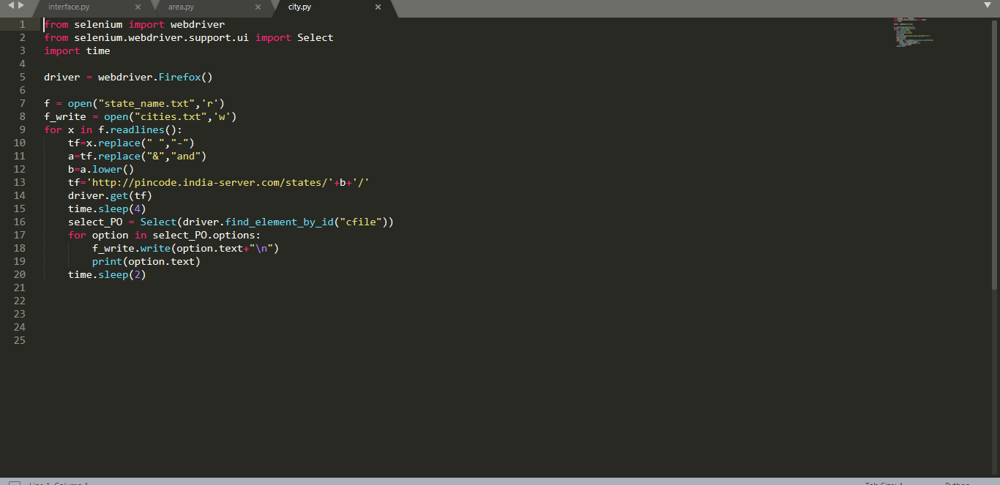
Data Gathering

Slide 11
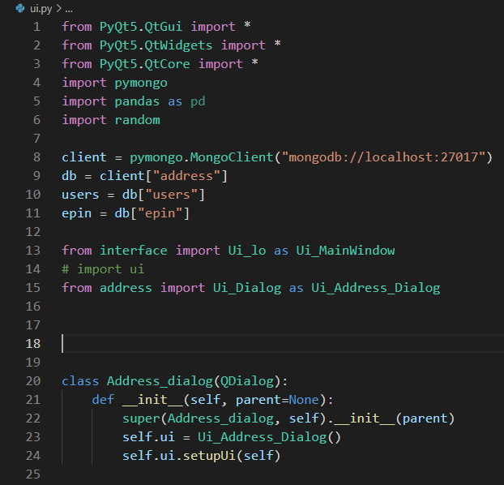
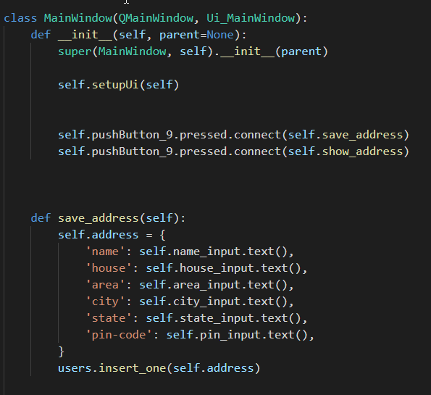
Software Interface

Slide 12
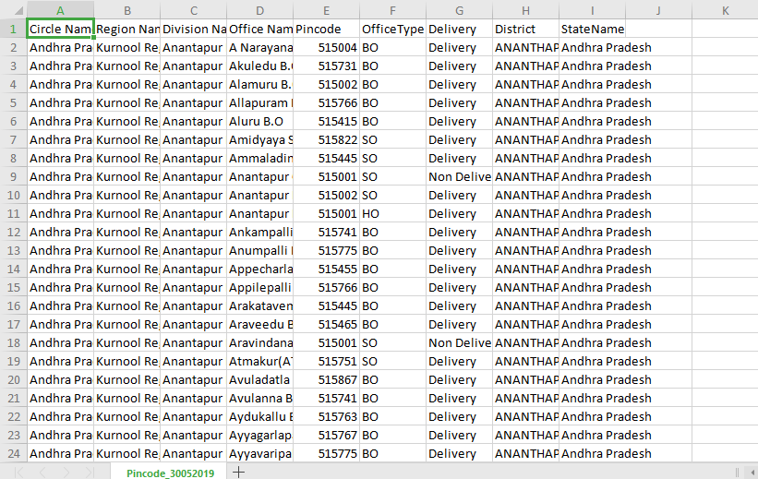
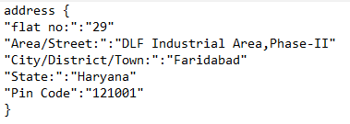
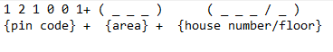

Slide 13
USE OF PROJECT
This system will do away with the complexity and hassles of providing
multiline often misspelled addresses and searching and
navigating to the doorstep of addresses in areas with
confusing and conflicting address naming and
ordering system.
It is also use for searching and navigating to an exact house number/
door number using the standard maps app on mobile.

Slide 14
EXISTING SYSTEM
In the existing software based on the same notion, it has been found that-
Inefficient data collection
Less data to work with
Less data security
Expensive software
Complicated
Higher memory utilization

Slide 15
ADVANTAGES
The advantages of the project is-
Reduction in redundancies and inconsistencies in data.
Implements user defined rules to ensure data integrity.
Ensures data access authorization.
Proper visualization of data.
User friendly.

Slide 16
BIBLIOGRAPHY
REFERENCES
http://www.mapmyindia.com/blog/tag/digital-address-system
http://www.tnooz.com/article/what3words-smashes-conventional-mapping-digital-first-address-system/
http://w3w.com
http://www.citocode.com/en
http://data.gov.in/catalog/all-india-pincode-directory

Slide 17
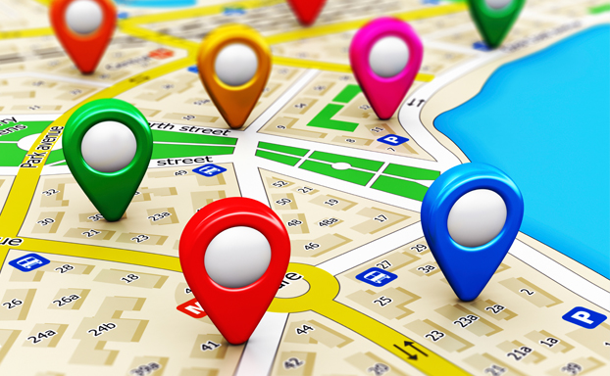
THANK YOU
JAY DUTT
AMIT SHARMA
SUMIT SHARMA
AJIT KUMAR MEHTA

